Slide 1
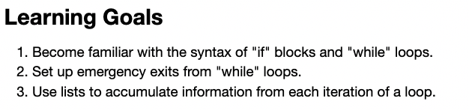
Recap: Little CGI learning goals

Slide 2
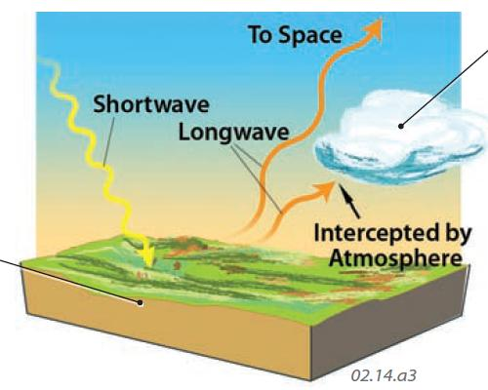
A “Simple Radiative Balance” (SRB) climate model
The net radiative flux is the imbalance (difference) between Absorbed Shortwave Radiation (ASR) and Outgoing Longwave Radiation (OLR).
ASR
OLR
If ASR > OLR, Earth will heat up
If ASR < OLR, Earth will cool down
https://geography.name/wp-content/uploads/2019/06/22.jpg

Slide 3

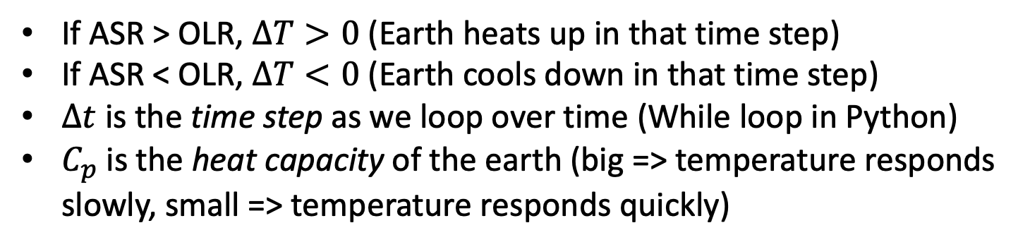
Implementation also requires a time step and a heat capacity
If ASR > OLR, $∆T>0$ (Earth heats up in that time step)
If ASR < OLR, $∆T<0$ (Earth cools down in that time step)
$∆t$ is the time step as we loop over time (While loop in Python)
$C_{p}$ is the heat capacity of the earth (big => temperature responds slowly, small => temperature responds quickly)

Slide 4

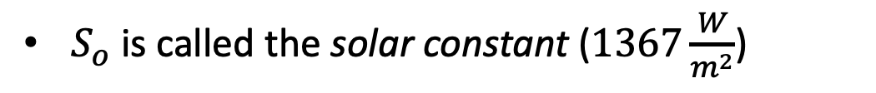

How to calculate ASR?
$S_{o}$ is called the solar constant ($1367\frac{W}{m^{2}}$)
$$S_{o}$$

Slide 5
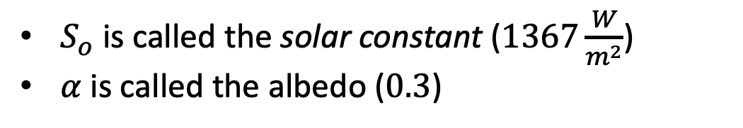

How to calculate ASR?
$S_{o}$ is called the solar constant ($1367\frac{W}{m^{2}}$)
$α$ is called the albedo ($0.3$)
$$α$$
$$S_{o}$$

Slide 6

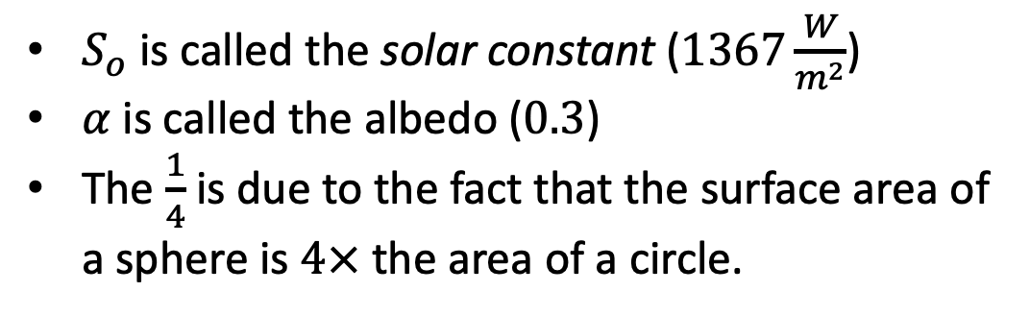
How to calculate ASR?
$S_{o}$ is called the solar constant ($1367\frac{W}{m^{2}}$)
$α$ is called the albedo ($0.3$)
The $\frac{1}{4}$ is due to the fact that the surface area of a sphere is $4×$ the area of a circle.
$$α$$
$$S_{o}$$

Slide 7

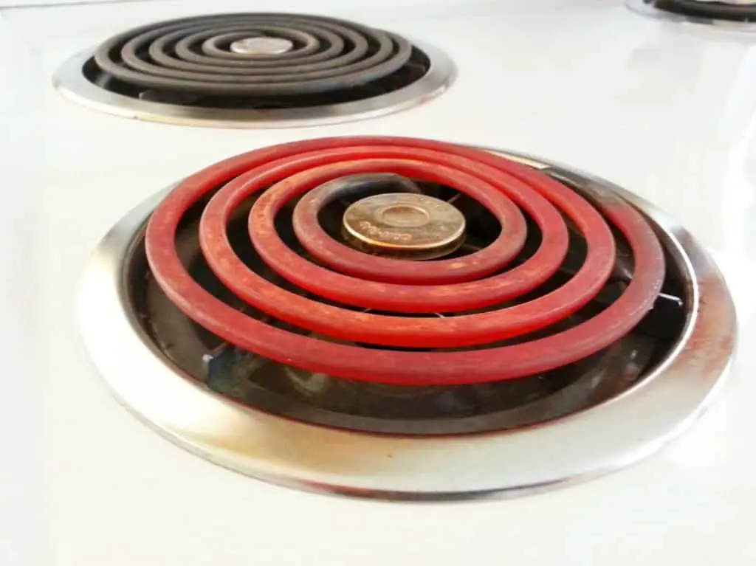
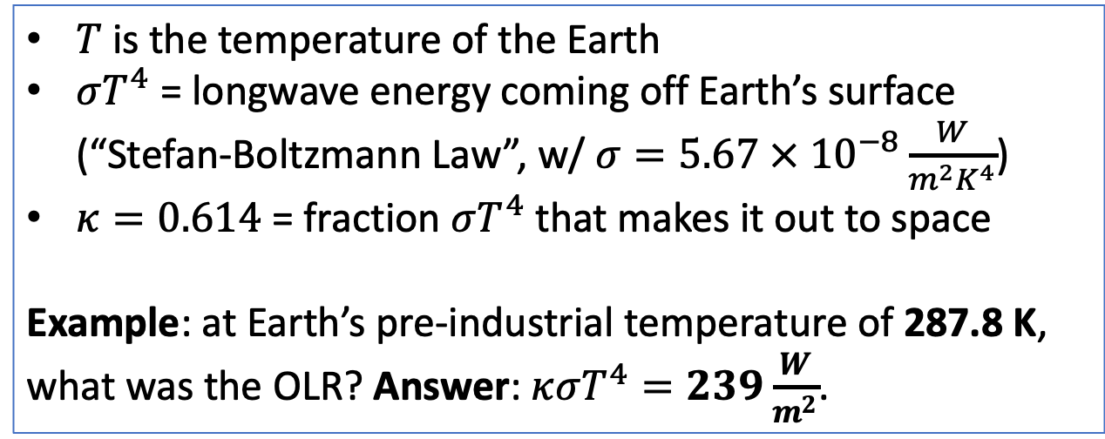

How to calculate OLR?
$T$ is the temperature of the Earth
$σT^{4}$ = longwave energy coming off Earth’s surface (“Stefan-Boltzmann Law”, w/ $σ=5.67 × {10}^{−8}\frac{W}{m^{2}K^{4}}$)
$κ=0.614$ = fraction $σT^{4}$ that makes it out to space
Example: at Earth’s pre-industrial temperature of 287.8 K, what was the OLR? Answer: $κσT^{4}=239\frac{W}{m^{2}}$.
The Stefan-Boltzmann law quantifies what you already know: an object emits a lot more energy when it’s hot, compared to when it’s cold.
$$T$$

Slide 8
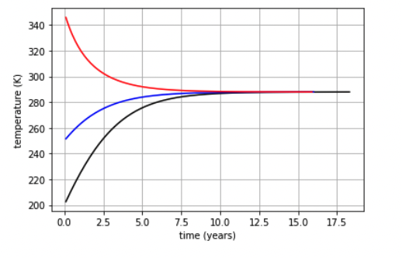
Calculating these at every step allows you to adjust Earth’s temperature at each step
Goldilocks Temperature (when ASR = OLR)

Slide 9
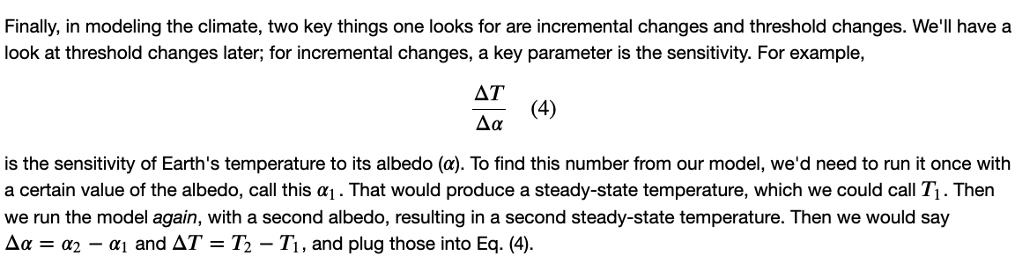
Climate sensitivity to changes in Earth’s albedo
Lower albedo or higher?

